Slide 1


The Kaleidoscope Behaviour Curriculum.

Slide 2
What is it?
A new curriculum very much like English or Maths.
It has a set of set routines to follow that become expectations of behaviour.
Each routine has a set of simple steps that will be taught just like writing a sentence or calculating a sum.
Pupils will be told why they are learning it so they understand.
It will be practised at all times and be consistent across the school and academy.

Slide 3
Our three new behaviour expectations:
BE RESPECTFUL
BE READY
BE SAFE
They are not rules, we have high expectations which will develop into the norm.

Slide 4
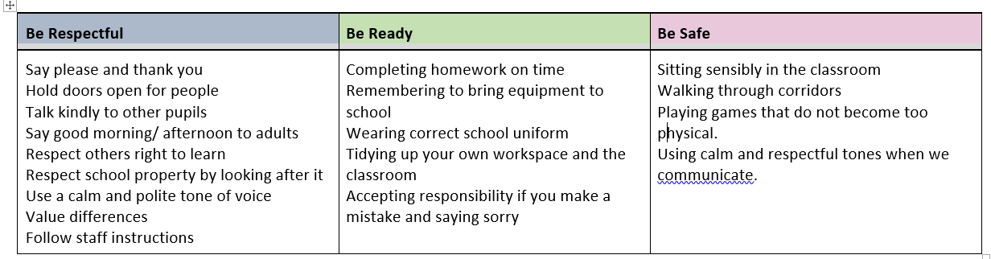
Examples of what this would look like in action...

Slide 5
The Behaviour Curriculum is based upon evidence based research:
Paul Dix (Behaviour Specialist)
Tom Bennett (Researcher in Education)
Stoke Park Primary School
Department for Education - Behaviour in School Guidance 2022

Slide 6
Why are we implementing a behaviour curriculum?
Research tells us that the way students behave in school is strongly correlated with their eventual outcomes
When behaviour is good:
Students achieve more academically and socially
There is more time for learning
Children are more likely to feel safe and happy at school

Slide 7
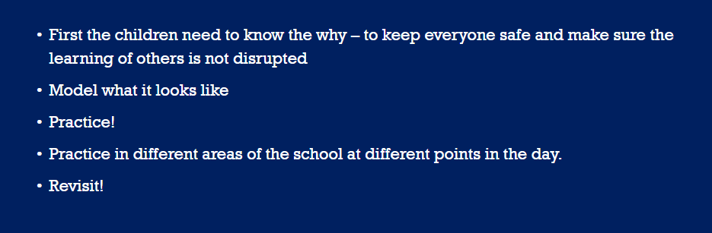
How do we teach it?

Slide 8
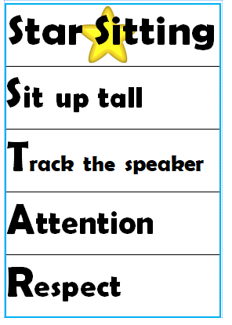
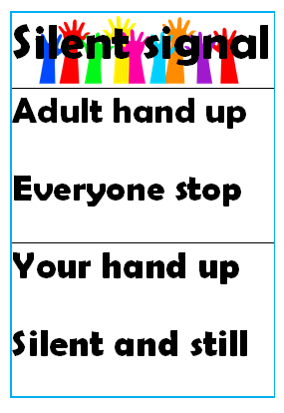

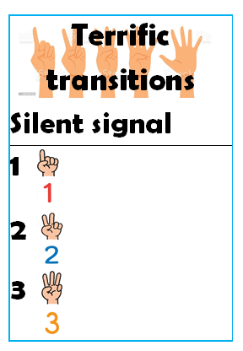
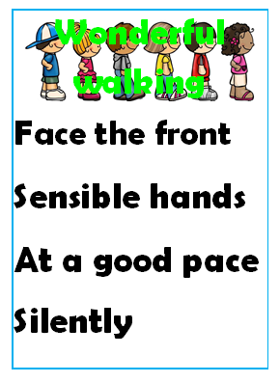
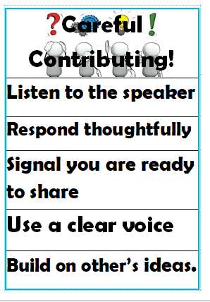
These are the routines taught to the children:

Slide 9
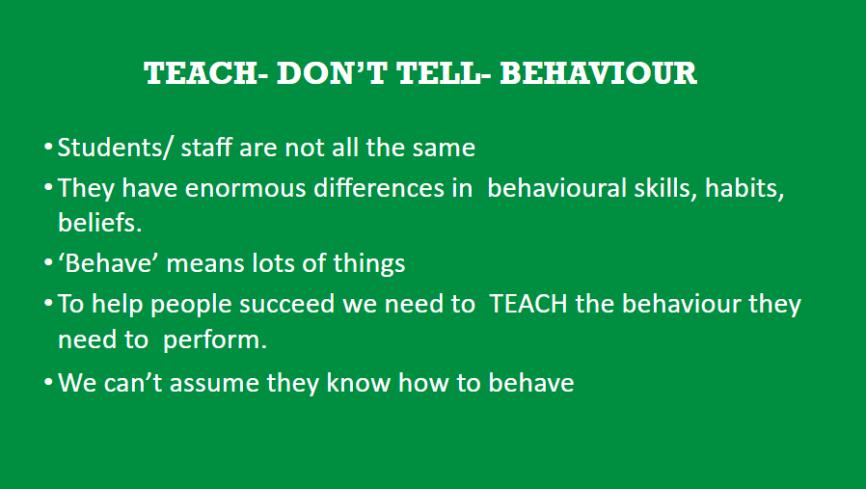


Slide 10
What about the children who might find it a challenge with these routines?
Identified children will have success plans created for them designed by all staff that support the child.
These plans will adapt the routine for them that still allows them to follow them.
The same high expectation is applied.

Slide 11
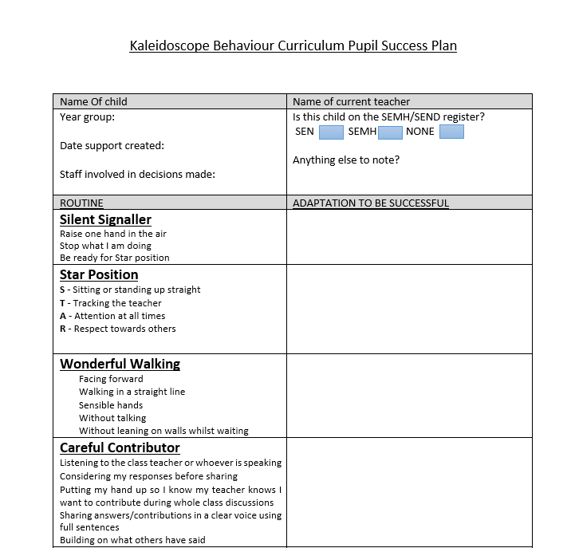
Success Plan

Slide 12
Consequences
What is the purpose of a consequence?
They have one primary effect, they deter. They give pause for reflection and make the recipient think, as they sit there “I might not do this again.”

Slide 13
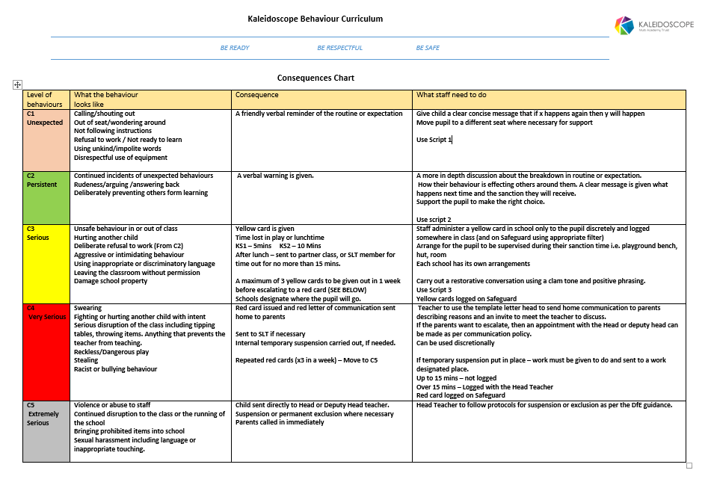
School/Staff Full Version

Slide 14
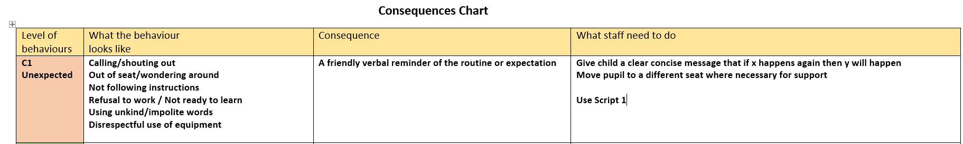
C1 - Unexpected
Teachers can use their judgement and discretion when giving this consequence. It might be that some children need a couple of reminders before moving to C2
Not exhaustive lists used.

Slide 15
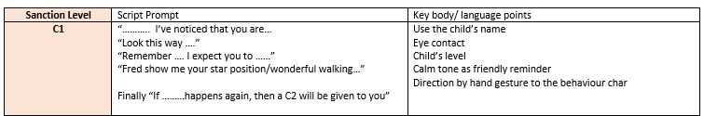
Script 1
A script is not:
A ritual to be followed and should not replace sincerity or professionalism

Slide 16
C2 - Persistent
The same applies to this stage and positive reinforcement of they can make the right choice before moving to C3.

Slide 17
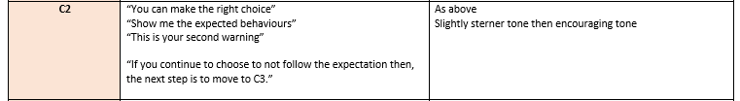
Script 2

Slide 18
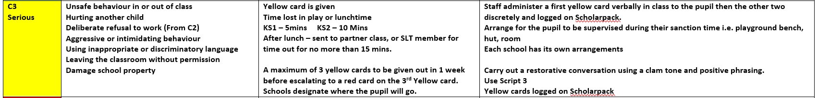
C3 - Serious
C3 begins the issuing of cards.
They have had all the warnings and reminders.
At each card stage a restorative conversation should be had to support the expectations and deter from the second card.
The first yellow card will be verbalised to the child then the second and third will be discretely given.

Slide 19
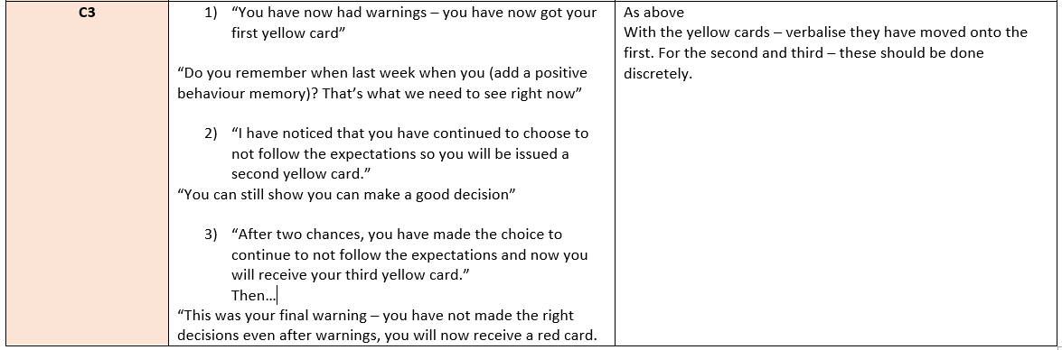
Script 3

Slide 20
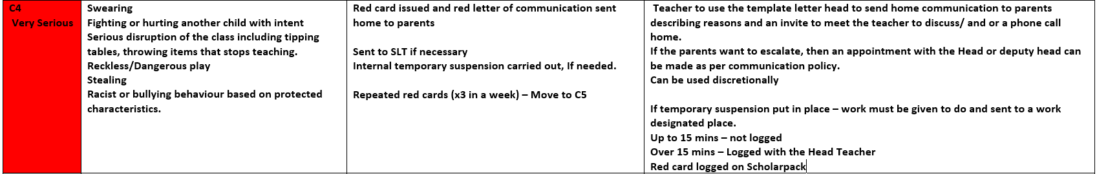
C4 - Very Serious
A red letter can be sent to parents based on the teacher’s judgement.
The actual red card issued may be enough deterrent for the pupil.
If a red card is received on a Friday afternoon, then the consequence will be carried over to the Monday of the next week and explained to both pupil and parent.

Slide 21
C5 - Extremely Serious
Please note that incidents can move straight to C4 or C5 based on the severity of the action.
Children also do not necessarily move from C4 straight to C5.

Slide 22
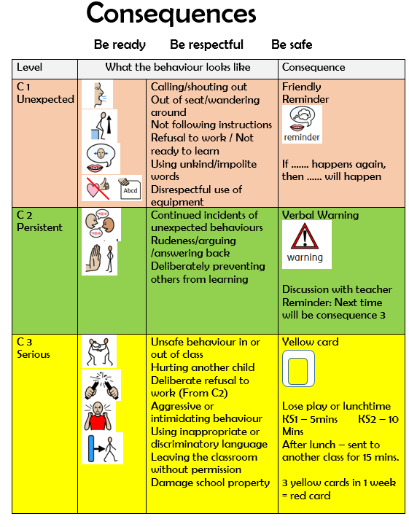

Slide 23
Points to remember:
The consequences are designed for both the behaviour curriculum routines and everyday behaviours/expectations.
It is not set in stone and teacher’s professional judgement is key - they know the pupils.
It is not a race to move through the stages to C5.
It is more about supporting conversations at each stage to prevent the pupil from moving onwards.
Every member of staff will be trained using the same consequences and language with the same expectations of when to move a pupil on.
Success plans are available to create and put in place for an individual regarding the routine expectations.
If no cards are issued in a day but only a reminder is given, then the next day begins a new.
Cards are cumulative through the week.
We want to improve behaviour and learning for everyone! ☺

